Slide 1

MagentaShift
SOLUTION THAT TURNS AT-RISK JOBS INTO BETTER CAREERS
Marek Čontofalský
Radoslav Čider
1

Slide 2

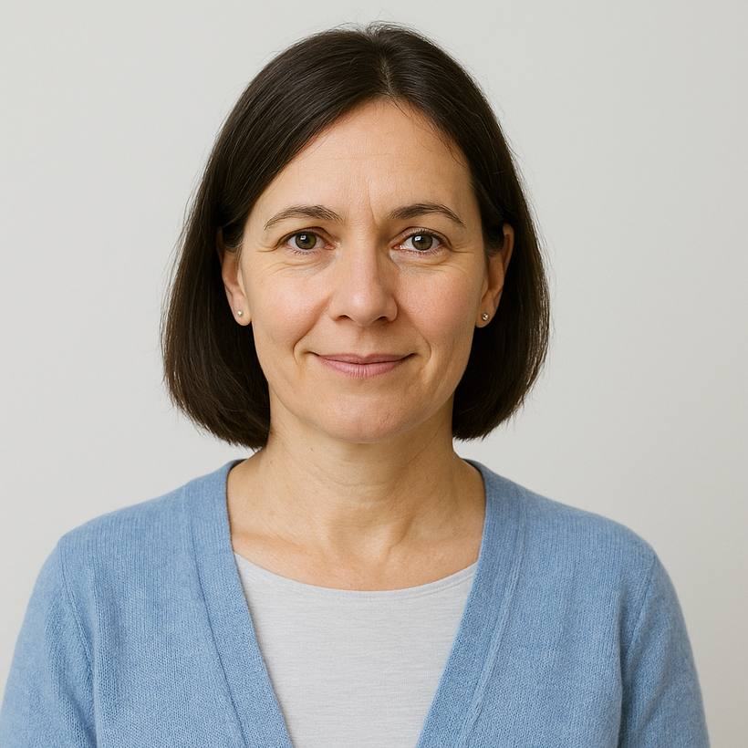
Meet Anna
Anna, 46 – Senior Support Team Lead, Telekom
18 years in call center
Reads that chatbots & AI will replace support
2

Slide 3
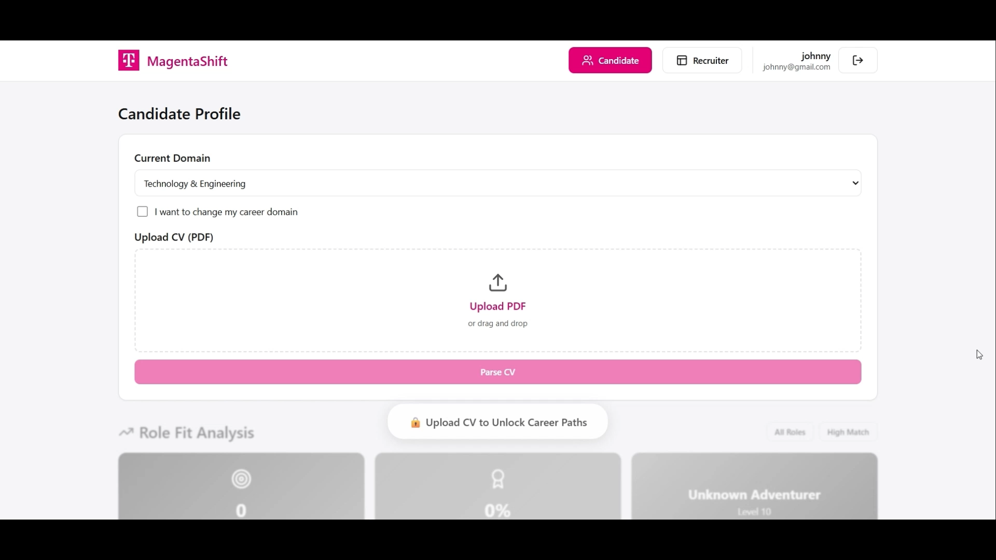
Our Solution
3

Slide 4



How IT works ?
CV parser
Data verification
Skill Tree
4

Slide 5
"We can’t stop AI from taking jobs, but we can make sure it doesn’t take people with them."
-Twoman SHOW

